Slide 1
Hadoop Ecosystem: kafka
Presented by: Ramya Sahitya Jakkula- 700737451
Vijay Bhargav Dungala- 700743008
Saathwik Sagar Siddam- 700740530
Ajay - 700734894
Pooja Ginjala - 700726912

Slide 2
Deamons of Kafka
Topics
Partitions
Consumer groups
Producer
Broker

Slide 3
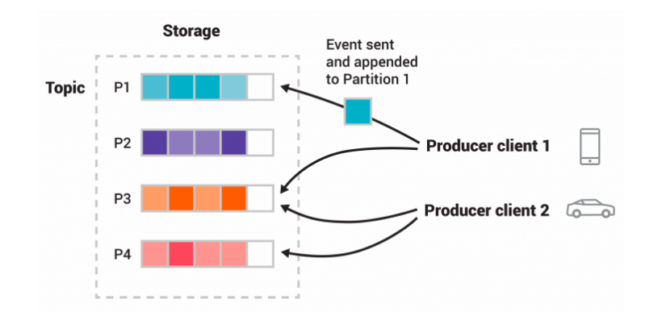
Kafka in nutshell

Slide 4
Kafka API’s
Admin API
Producer API
Consumer API
Kafka Streams API
Kafka Connect API

Slide 5
What kafka is used for?
For real time streaming data architecture
Website activity tracking
Metrics collection and monitoring
Log aggregation
Real time analytics
Rngesting data into Hadoop
Reply messages

Slide 6
Real life example of Kafka use case
A lot of large companies who handle a lot of data use Kafka. LinkedIn, where it originated, uses it to track activity data and operational metrics. Twitter uses it as part of Storm to provide a stream processing infrastructure. It's also used by other companies like Spotify, Uber, Tumbler, Goldman Sachs, PayPal, Box, Cisco, CloudFlare, and Netflix.

Slide 7
Kafka Alternatives
Google Cloud Pub/Sub
MuleSoft Anypoint Platform
G2 Deals
Confluent
IBM MQ
RabbitMQ
Amazon MQ
KubeMQ

Slide 8
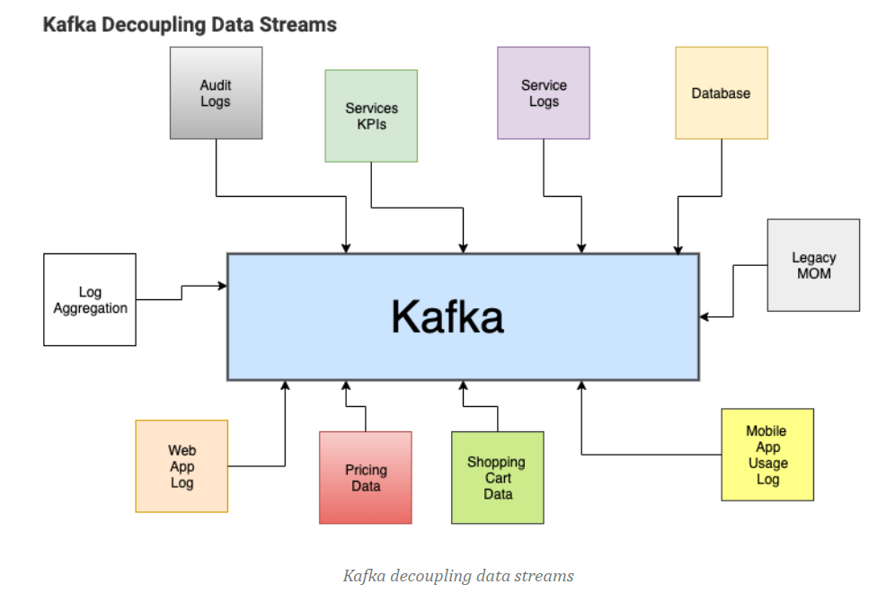
How Kafka does streaming?

Slide 9
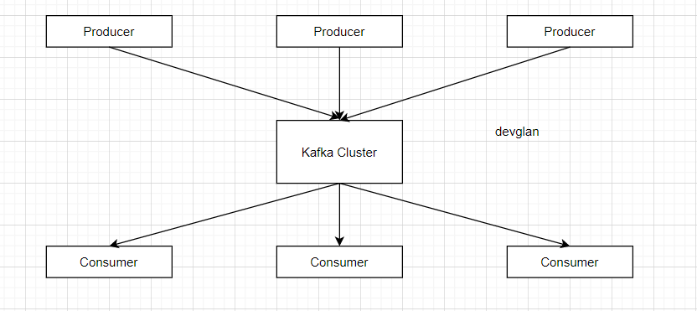
Kafka Architecture

Slide 10
Why Kafka is popular?
Proven
Scalable
Fault-tolerant
Flexible
Reliable

Slide 11
Kafka CLI Commands
Starting Zookeeper server:-
kafka/bin/zookeeper-server-start.bat \
kafka/config/zookeeper.properties
Creating Kafka Topic:-
bin/kafka-topics.bat –create –bootstrap-server localhost:9092 –replication-factor 10 –partitions 3 –topic movies

Slide 12
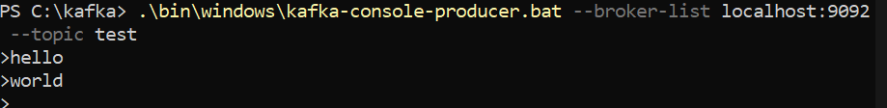
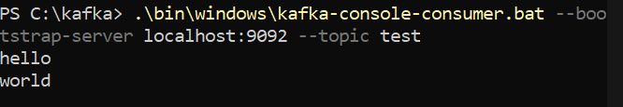
Kafka CLI commands contd.
Kafka Producer CLI command:-
kafka-console-producer.bat --topic movies --bootstrap-server localhost:9092
Kafka Consumer CLI command:-
kafka-console-consumer.bat --bootstrap-server localhost:9092 –topic movies –from-beginning

Slide 13
Thank you
Notes:
Kafka webpage here

